Slide 1
Wall Street Trade
Objective-Oriented People
Mayuri Gupta · Martin Duong · Ruchit Patel · Aishwarya Ravi

Slide 2
Problem Statement
Increase in new traders who have little to no knowledge about stocks
Many trading platforms are difficult to use and understand
Certain trading platforms do not let the user create an account without a minimum balance
Prospective investors need to set aside capital to start trading

Slide 3
Solution
All-in-one web application that is highly scalable and provides stock details to beginners
Simplistic UI gives information on trending and most followed stocks
Simulated Trading Platform with paper money.

Slide 4
Features
Add / Update ticker
Get stock information
Get company insight
Get trending tickers
Get top gainers / losers
Get sector performance
Get stock rating
Get similar stocks
Add / Update user credits
Buy stock and add to portfolio
Sell stock
View portfolio
Get market hours
Get stock news
Get stock mentions on Reddit
Get real time stock price (Amazon Lex)
Custom login & SSO (Google)

Slide 5
Tech and Tools Stack
Cloud Stack
AWS VPC
AWS RDS
AWS EC2
Auto Scaling Group
AWS Launch Template
AWS NAT Gateway
AWS Internet Gateway
AWS Route Tables
AWS ALB
AWS ACM
AWS Security Groups
AWS Subnets
CloudWatch
R53
Amazon AMI
AWS Lambda functions
API gateway
Amazon Lex - Chat Bot
JavaScript (Frontend)
React/Redux (Frontend)
Python (Backend)
Flask (Backend)
SQL/PSQL (Postgres DB)
Jenkins (CI/CD) - Automate deployment
Hashicorp Terraform (IaC)
Docker (Containerization)
Github (SCM)
Integration with Yahoo Finance API

Slide 6
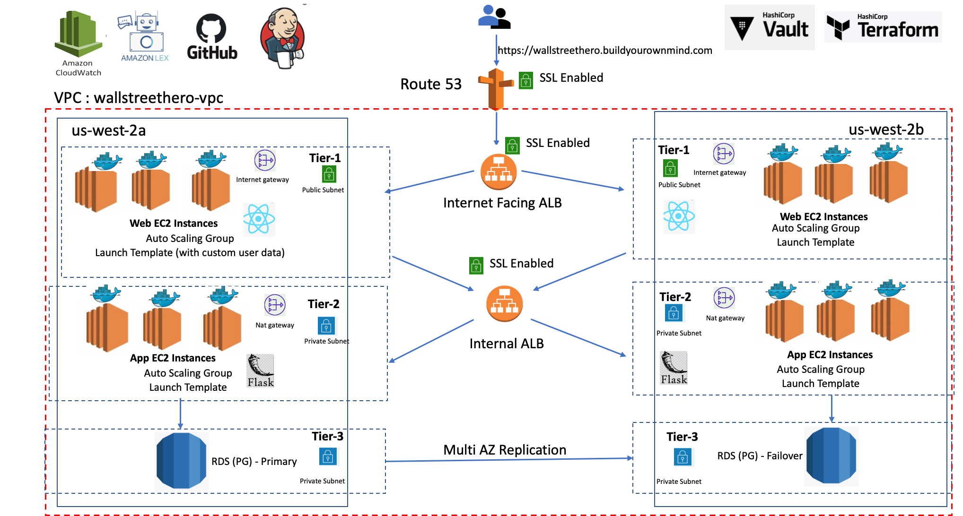
Architecture

Slide 7
Container Technology
Dockerfile is in Code repository which is used to build the image on jenkins server.
Dockerfile handles dependency management.
bash script to start the flask backend server.[as an entrypoint in dockerfile]
Secret management - HashiCorp Vault .
Python script in code to connect to vault and read secrets.
Mount the secrets to docker container in docker run command
bash script exist in user data of launch templates which spin up the instances with ASG .
wall_street_backend
Docker build
Image
Docker Hub
wall_street_frontend

Slide 8
CI/CD Pipelines
Jenkins is installed on EC2 Instance and provisioned over internet via R53.
Used Jenkinsfile in Code repository(Combination of Groovy and Bash script)
Multi-stage build pipeline with declarative syntax.
Git Checkout
Build Image
Push Image
Image clean up
Deploy
Teardown
Docker Hub
ASG
launch
User data Launch Templates
Running Container

Slide 9
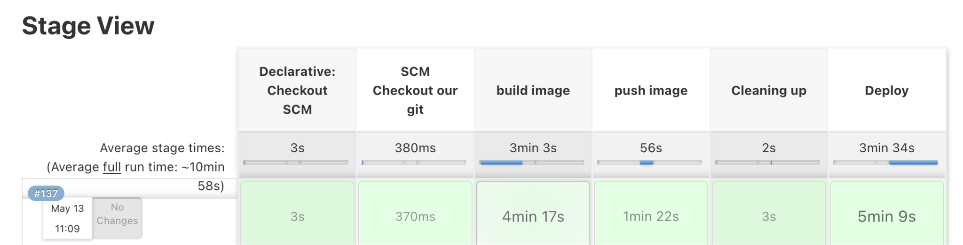
Pipeline

Slide 10
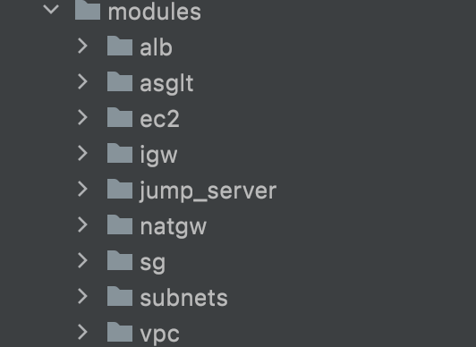
Infrastructure as Code
TERRAFORM
Jenkinsfile - in Github repository

Slide 11
DEMO

Slide 12
Thank You!

